Slide 1
Towards human-level 3D scene understanding: experiments and modeling benchmarks
Embodied Intelligence
9.12.22

Slide 2
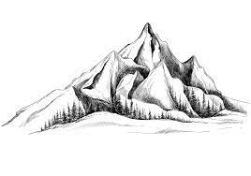
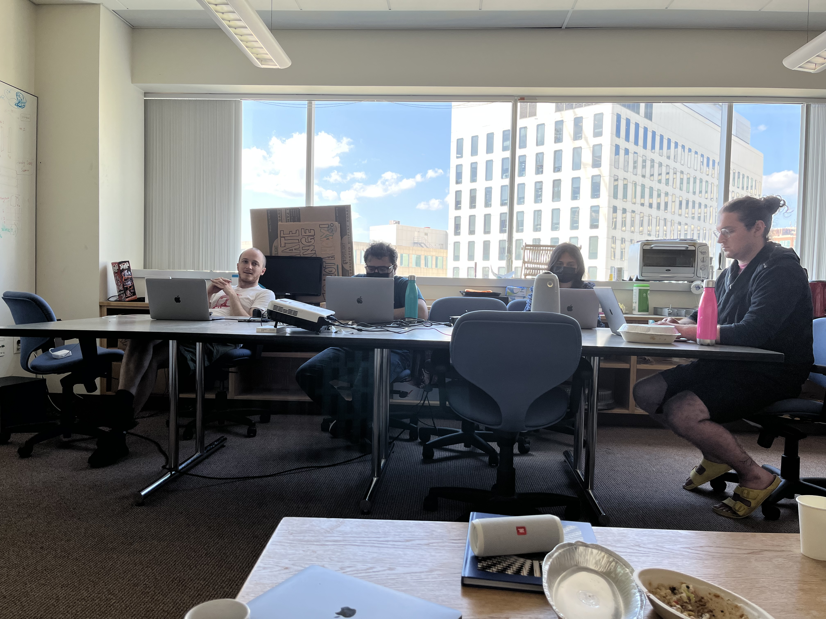
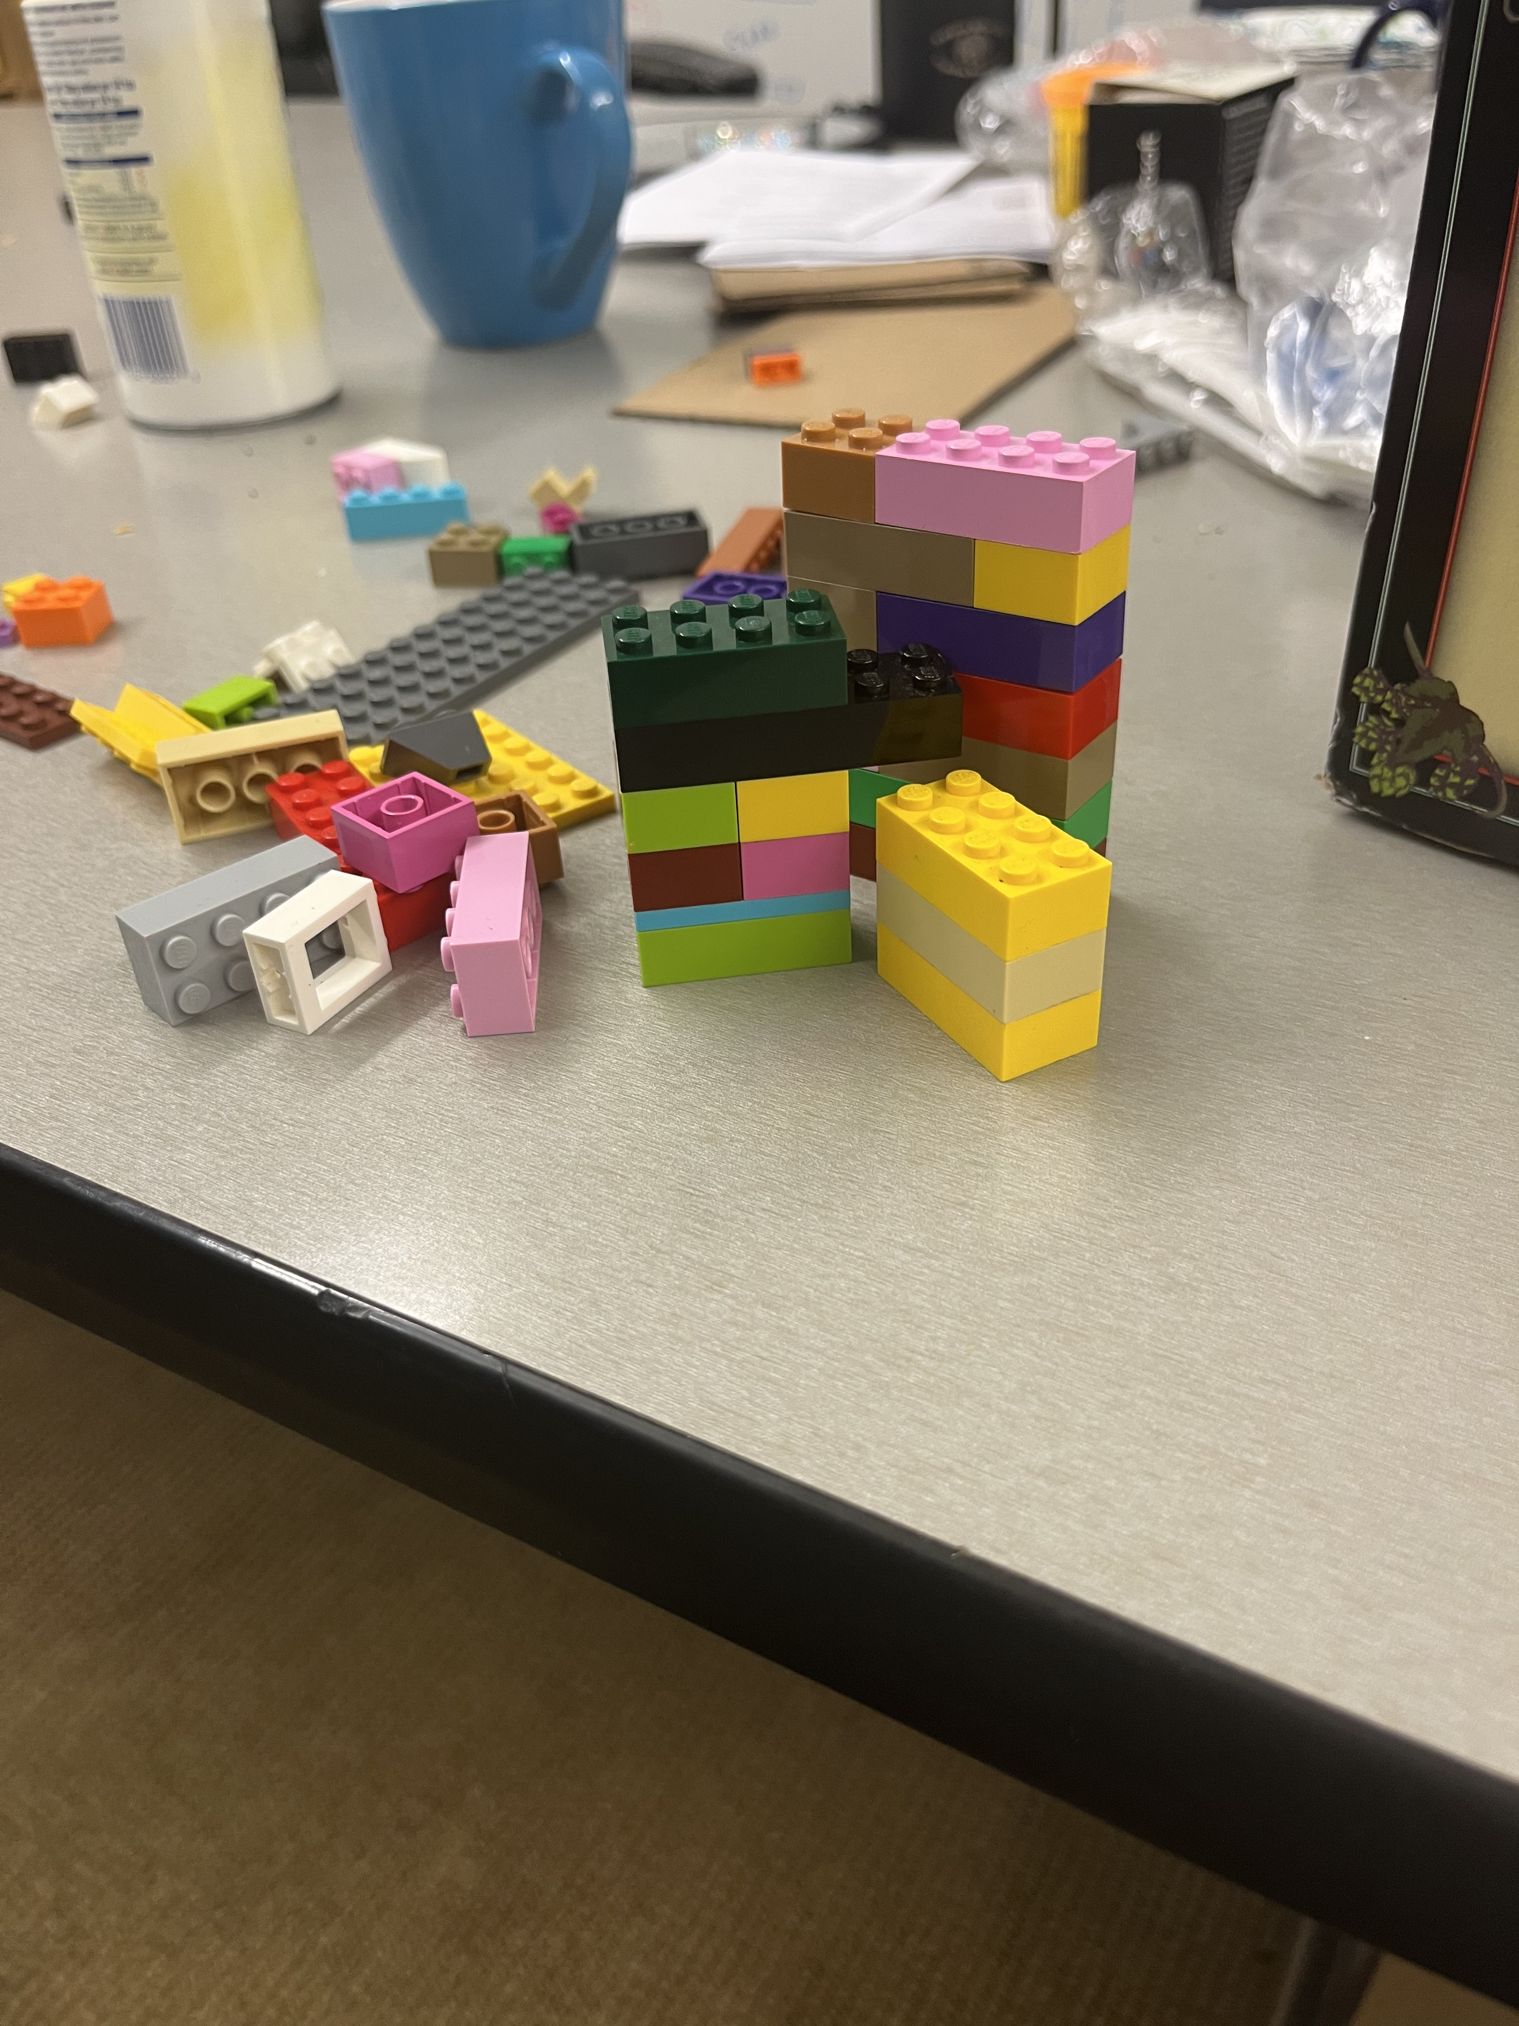

Humans perceive rich, stable 3D structure in all sorts of scenes

Slide 3

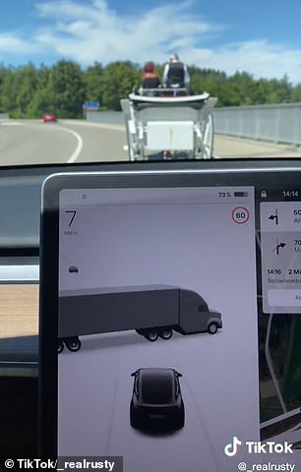
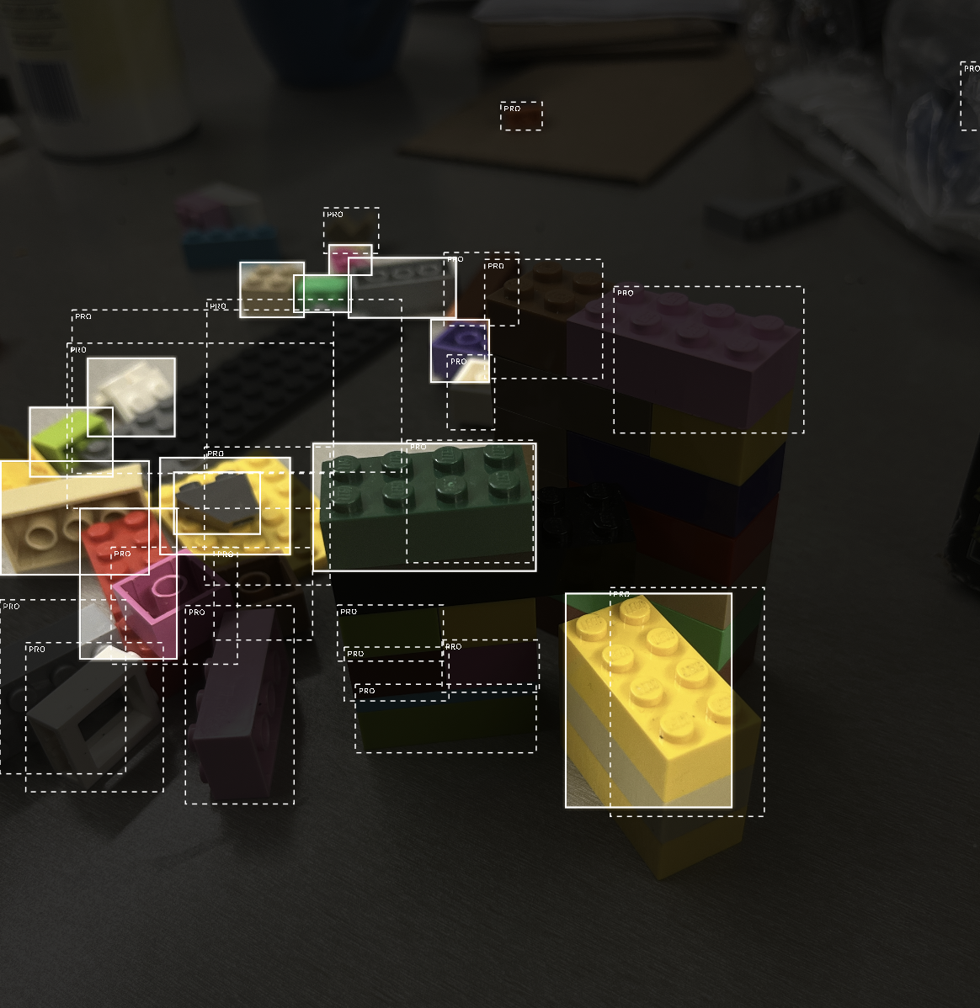
Humans perceive rich, stable 3D structure in all sorts of scenes
This contrasts with AI perceptual systems, which are brittle and generalize poorly
How do we bridge that gap, and how can we evaluate whether an AI perceptual system has achieved some measure of human-like perception?
Object detection missing objects in plain sight
Tesla Perception system failure
BrickIt – dedicated lego parser, failing to parse legos
when faced with occlusion

Slide 4
Probing Mid-Level Visual Representations
Test people on a variety of mid-level visual tasks:
Object localization / segmentation
Relative Depth Estimation
Surface Normals
The benchmark should ideally provide a spread of human performance, to serve as a worthwhile comparison for models
To that end, we developed a novel, artificial dataset

Slide 5
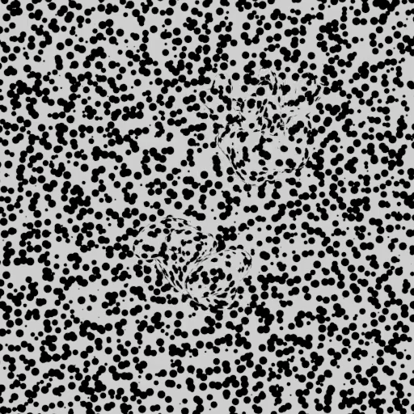
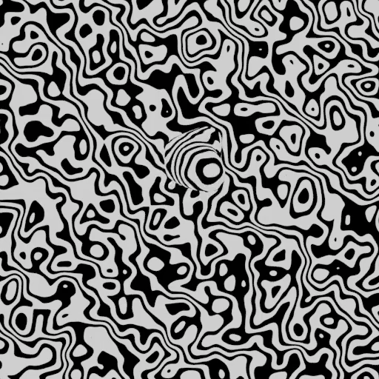
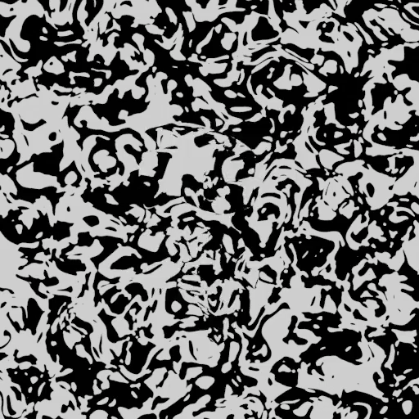
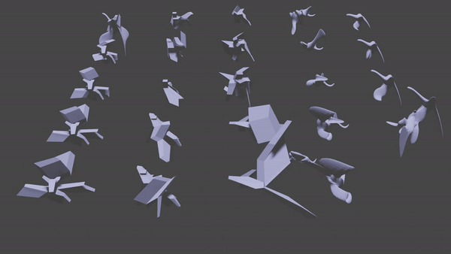
“Out-of-Distribution” Gestalt Style Scenes

Slide 6
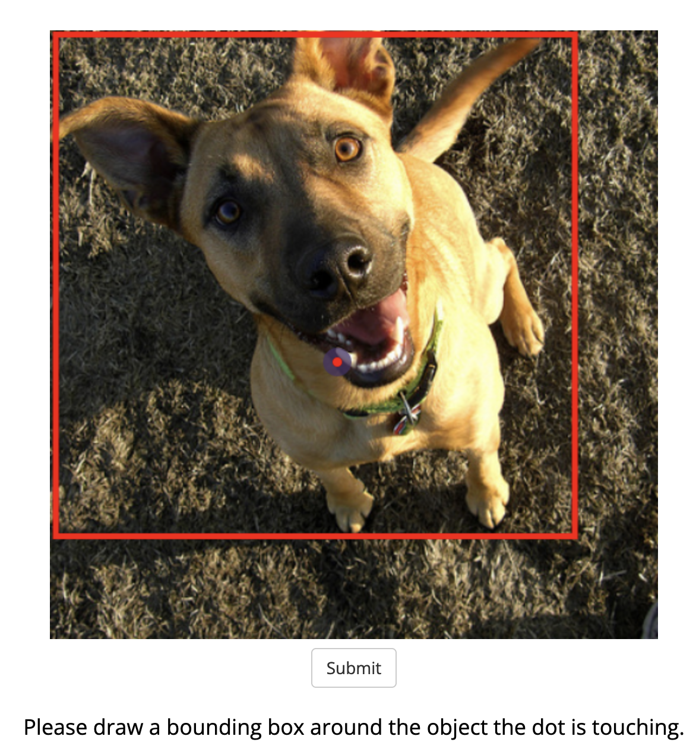
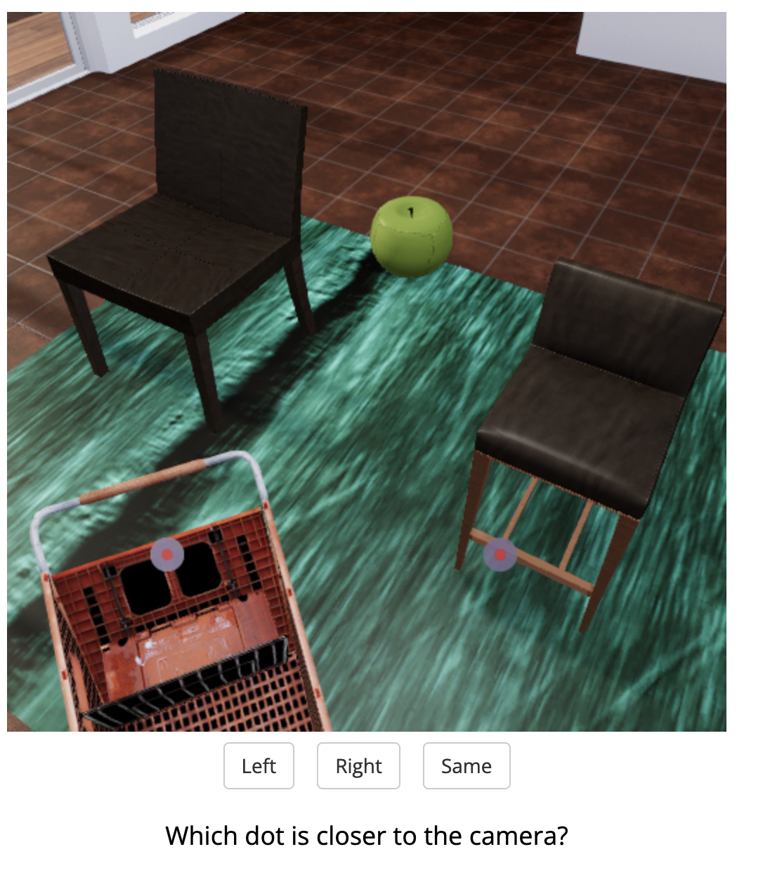
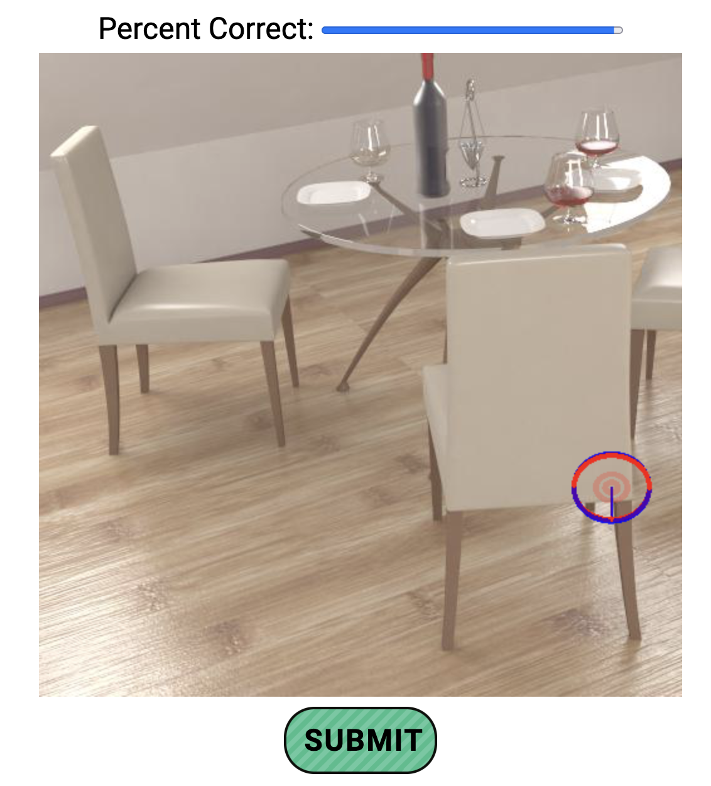
Experiment Goals
Object Localization
Probe various mid-level representations:
Object localization / segmentation
Depth Estimation
Surface Normal Estimation
Naturalistic baseline datasets:
TDW
Hypersim
NSD
Relative Depth
Surface Normals

Slide 7
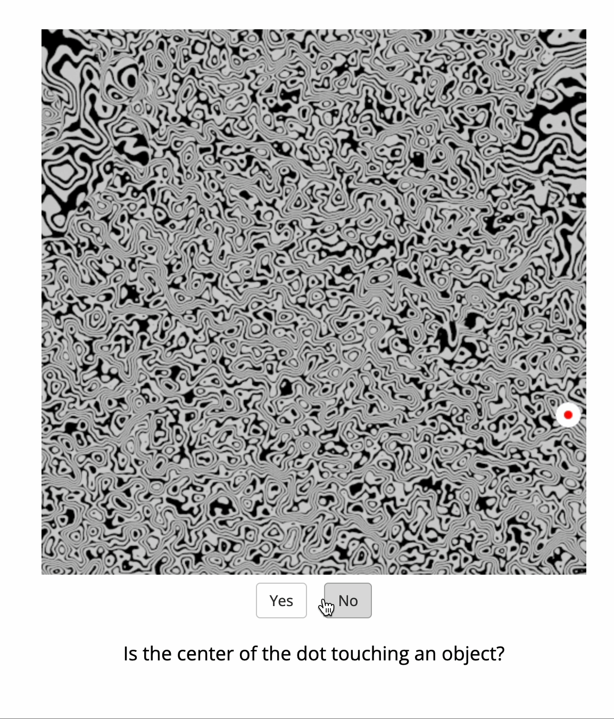
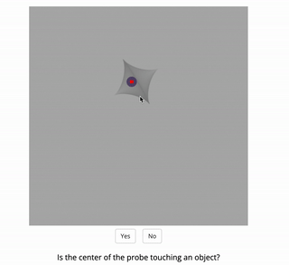
Object Localization

Slide 8
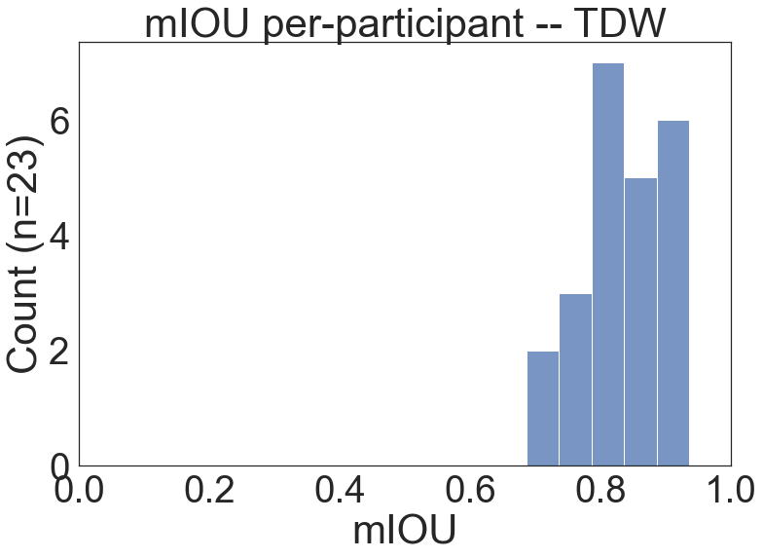
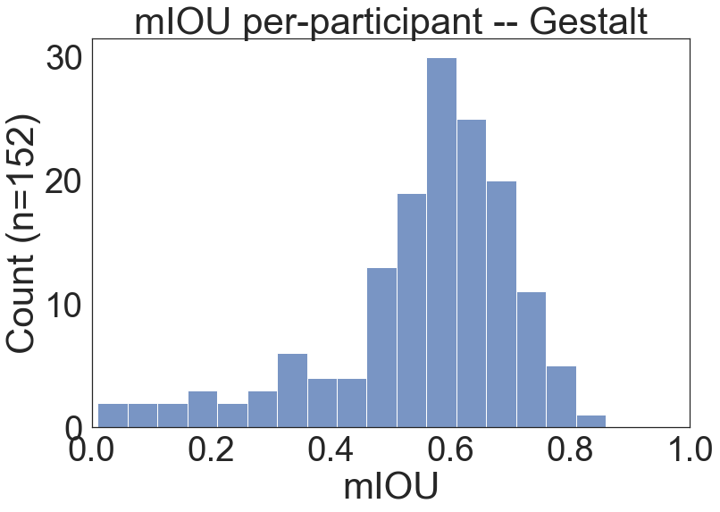
Obj loc

Slide 9
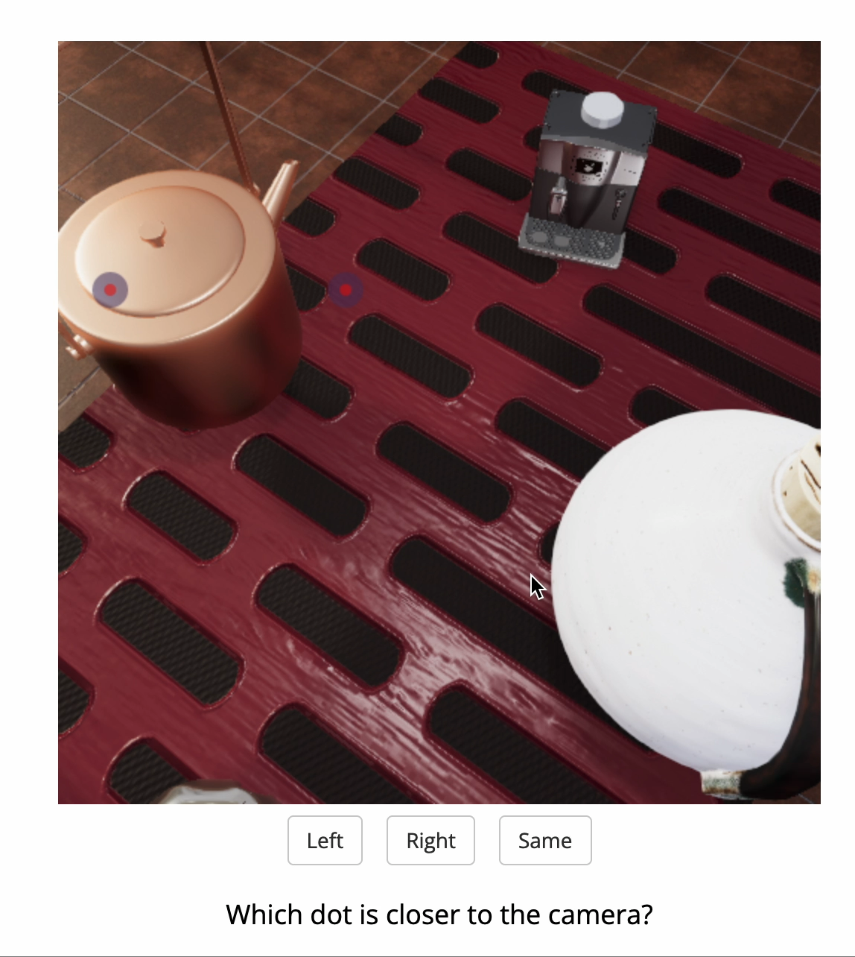
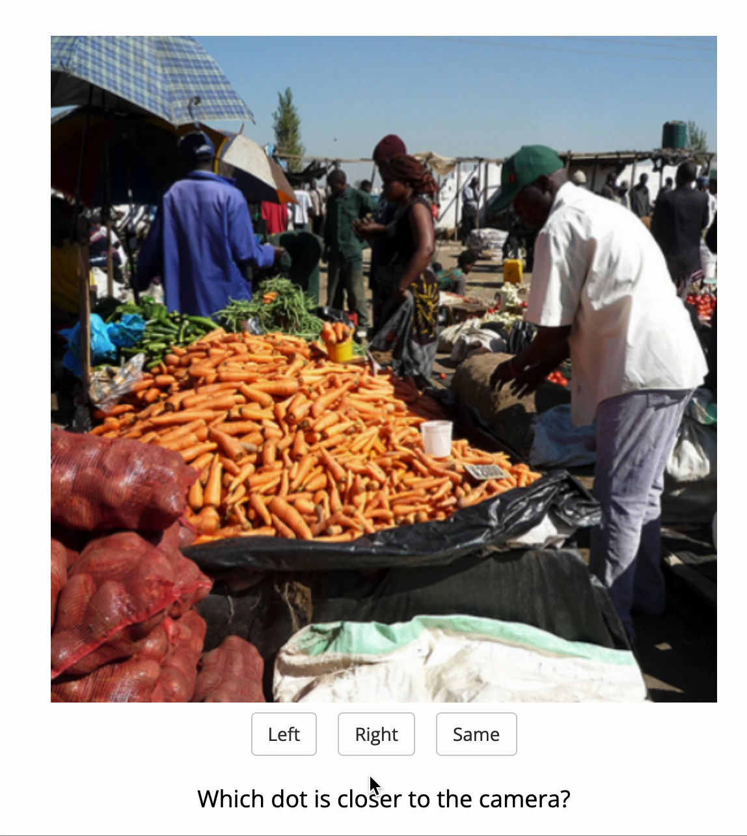
Relative Depth Estimation

Slide 10
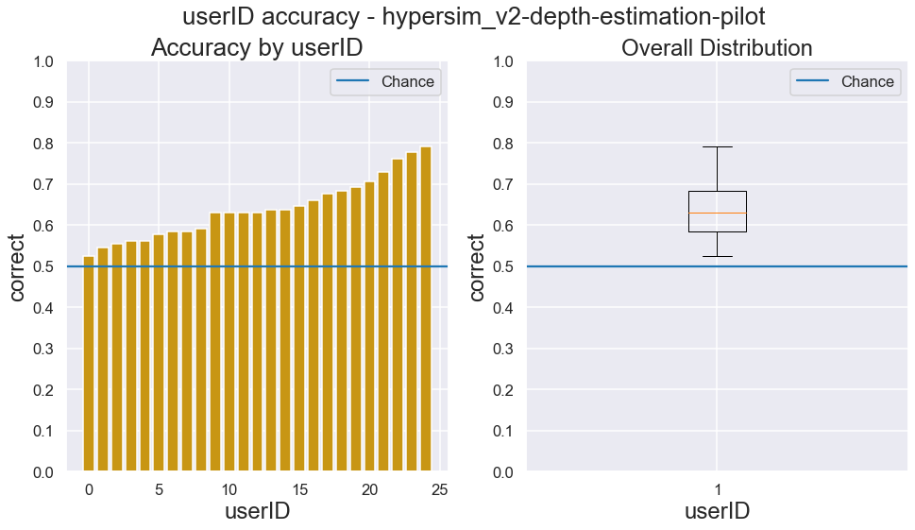
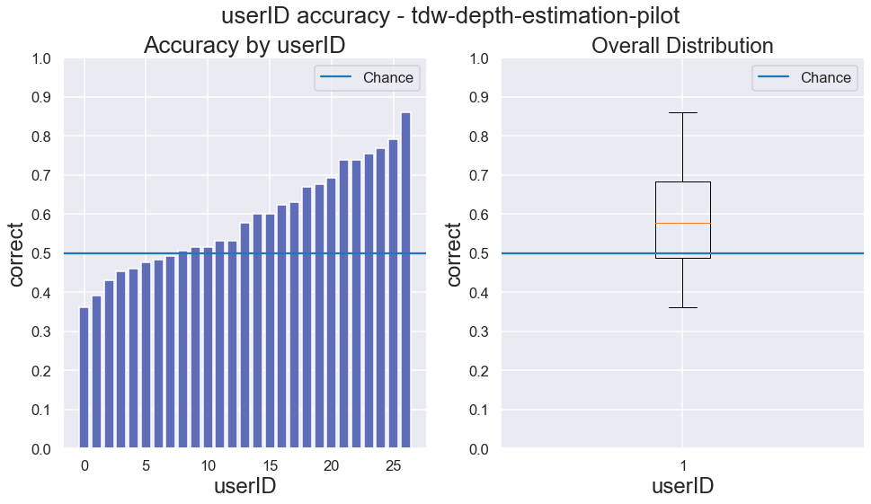
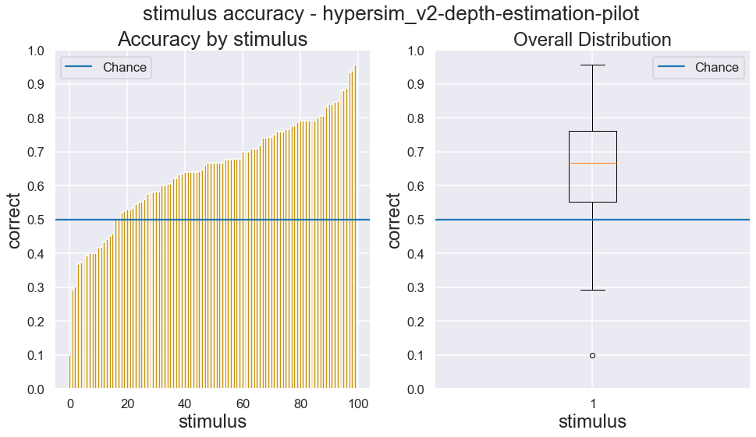
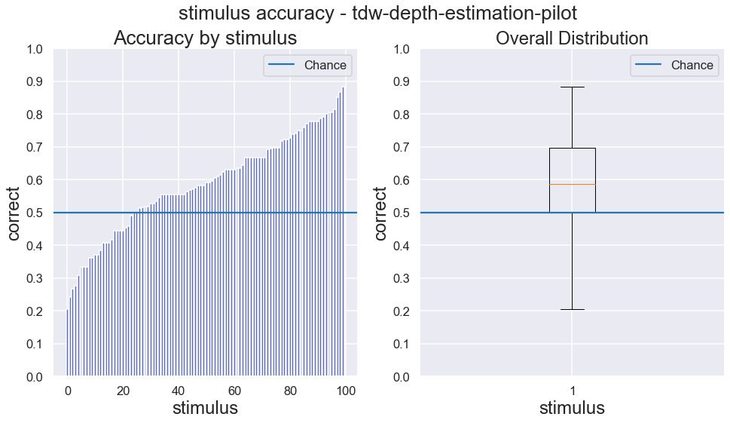
Hypersim
TDW
User
Accuracy
Stimulus
Accuracy

Slide 11
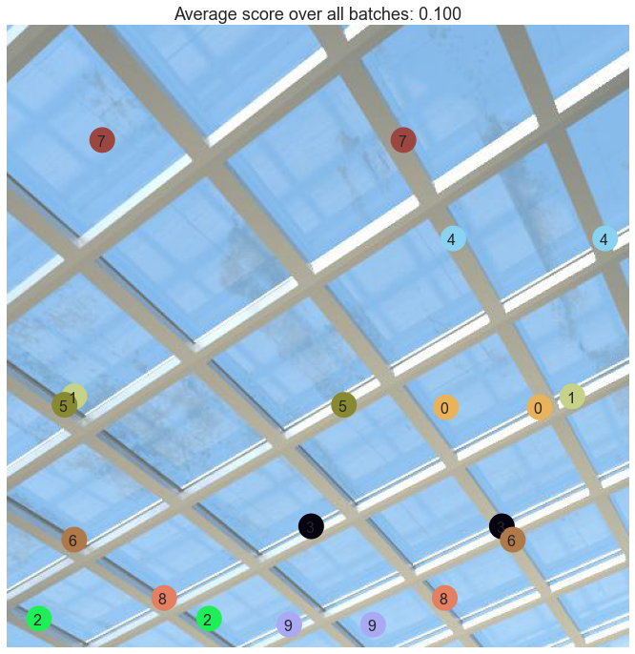
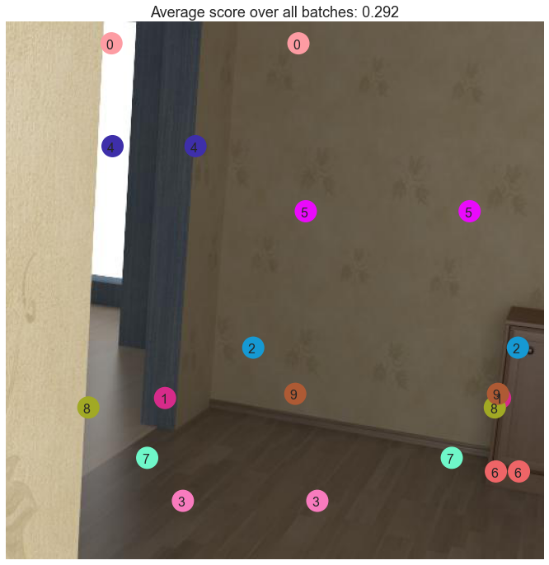
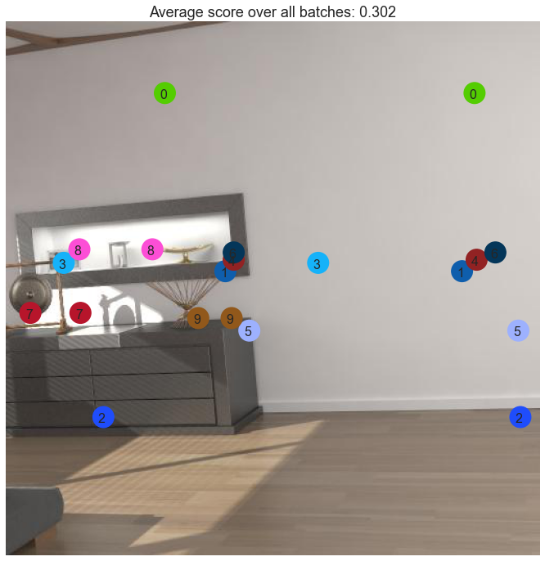
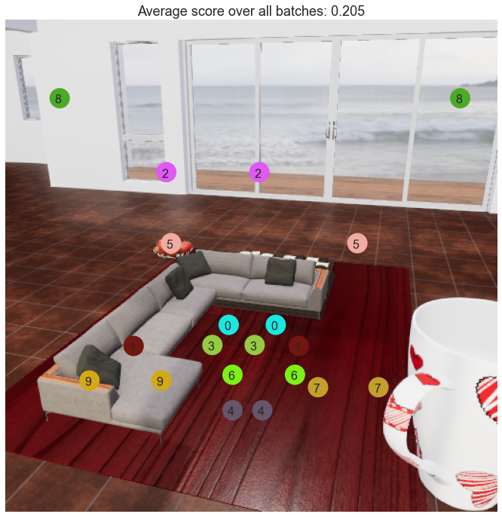
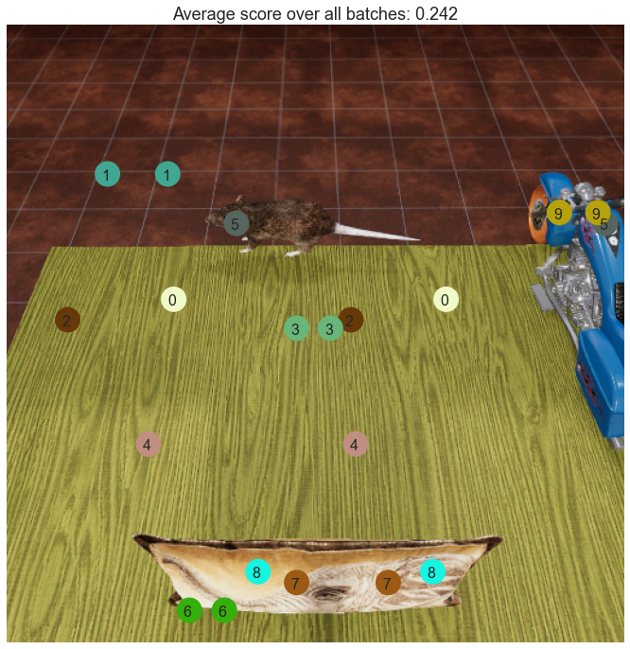
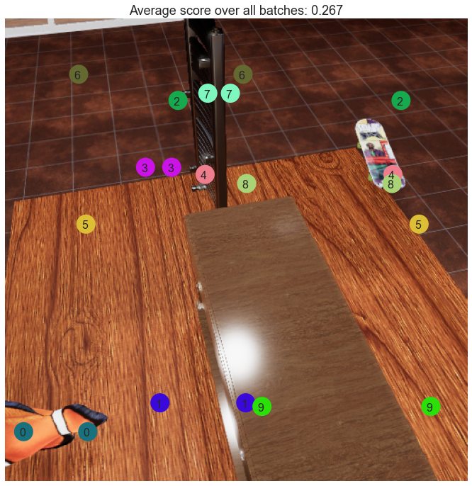
Worst Scoring Images
Hypersim
TDW

Slide 12
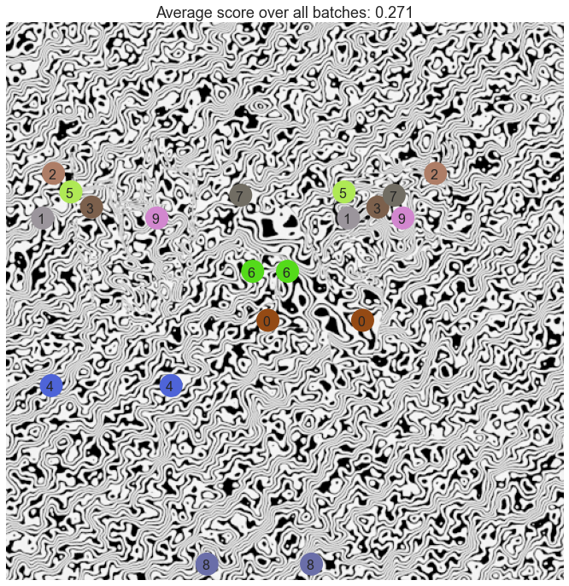
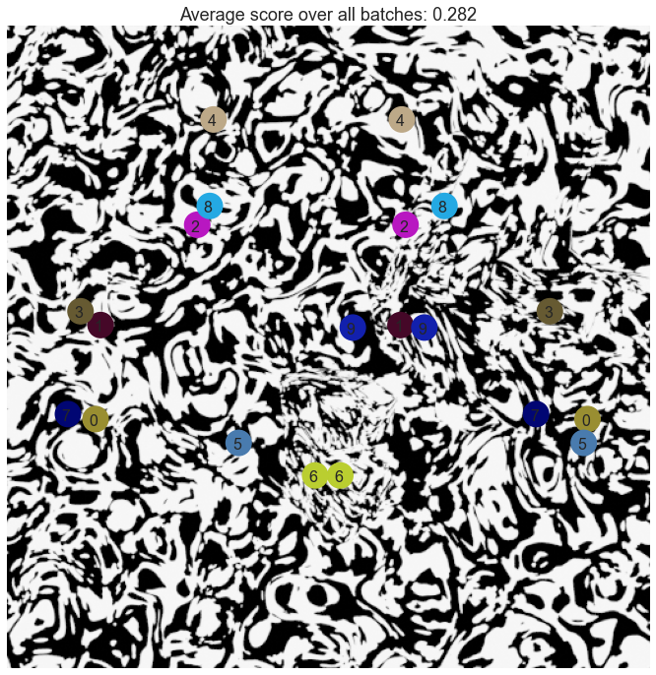
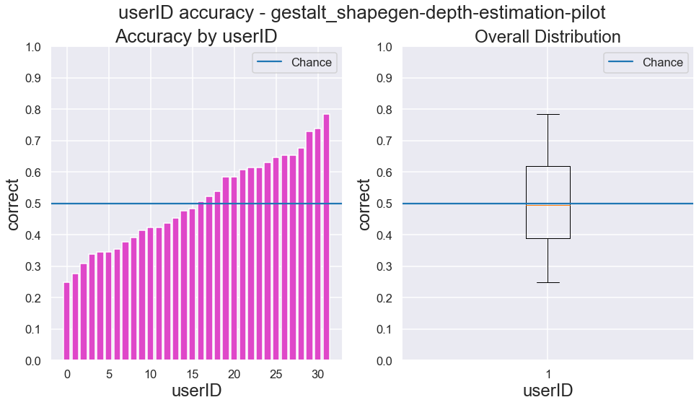
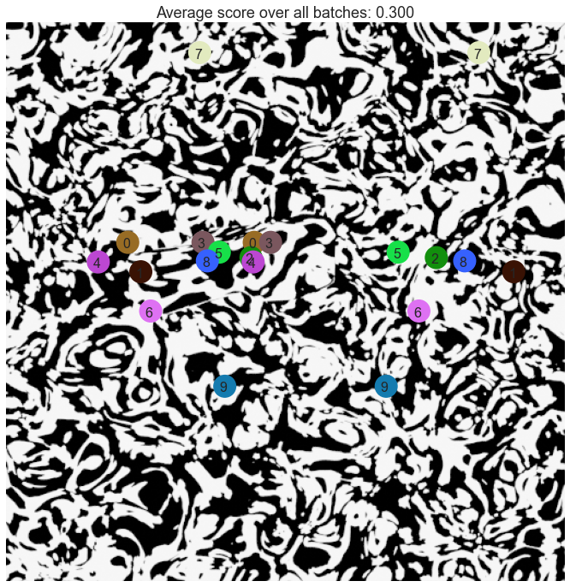
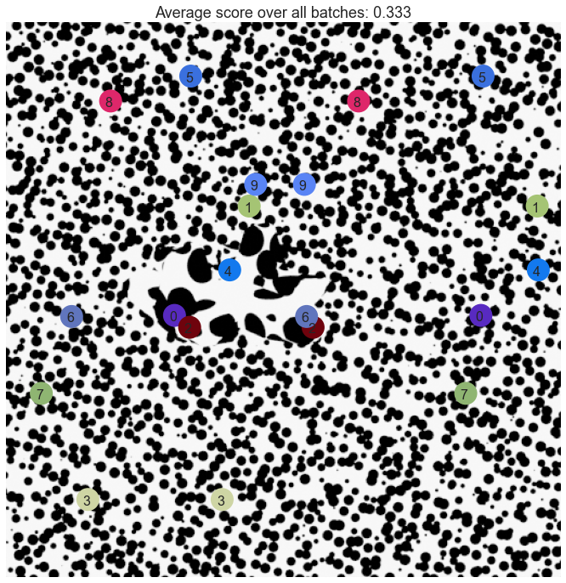
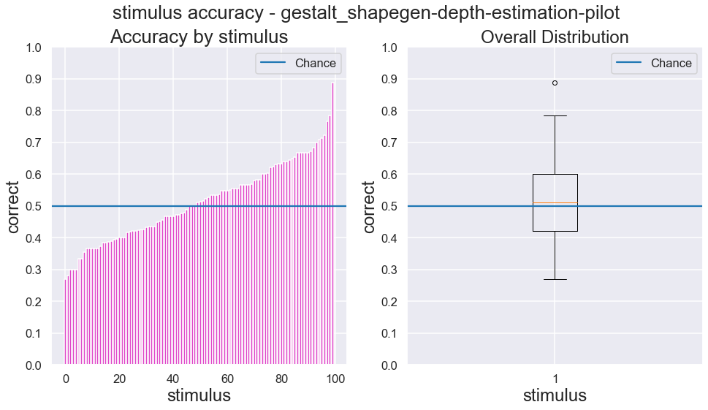
Gestalt Relative Depth Estimation Results

Slide 13
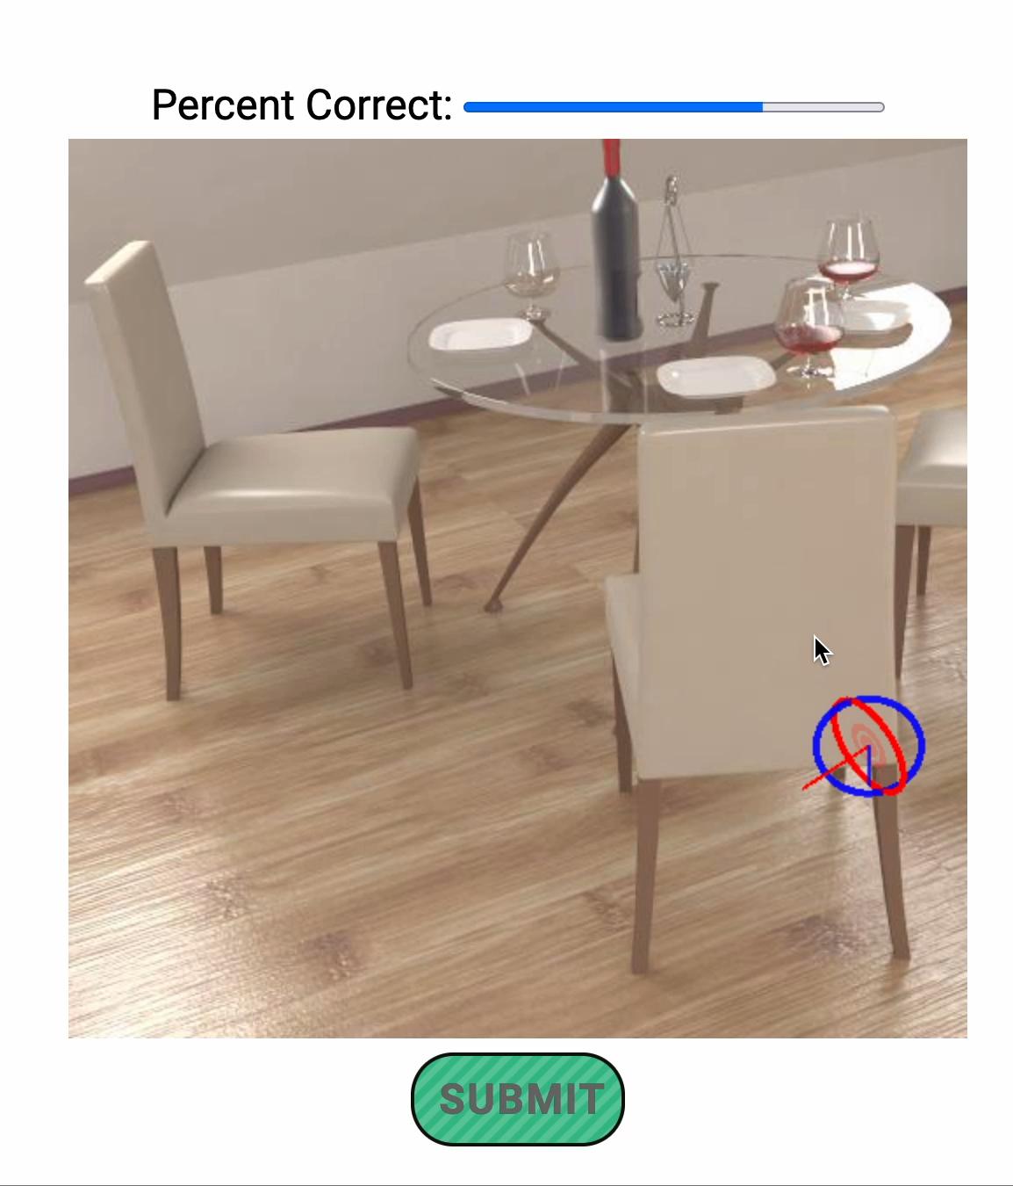
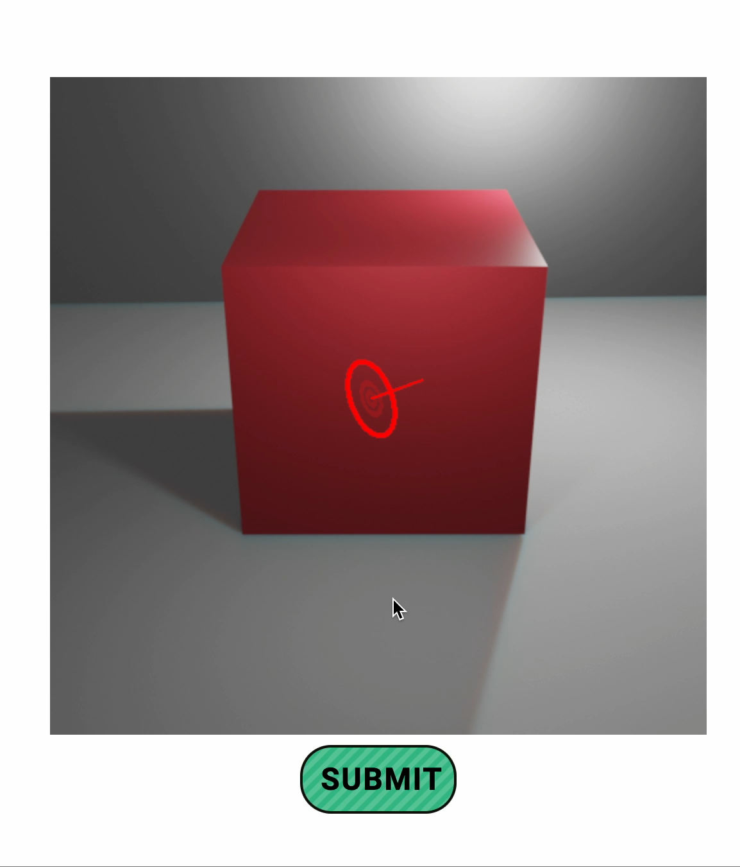
Surface Normal Task
Practice Trial
Attention Check

Slide 14
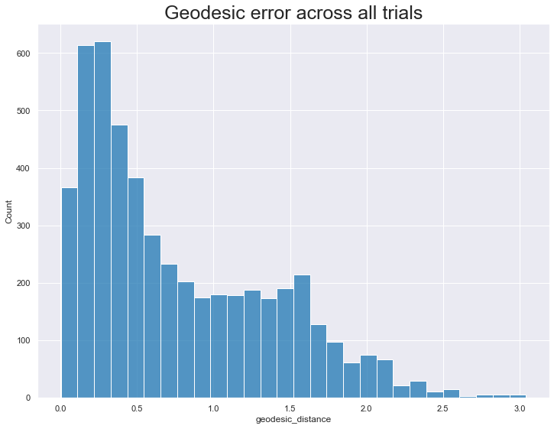
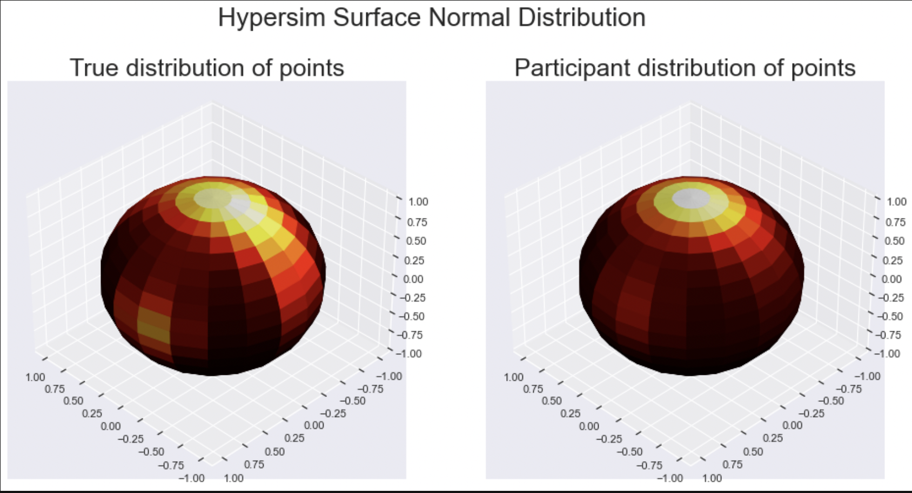
Surface Normals – Hypersim

Slide 15
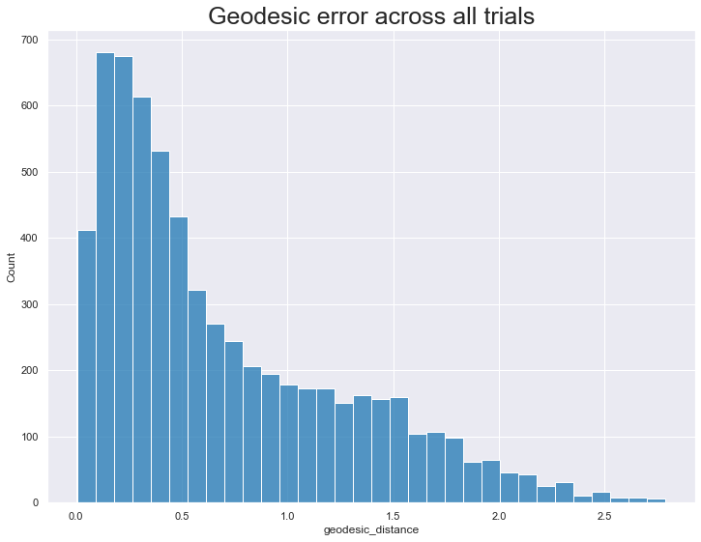
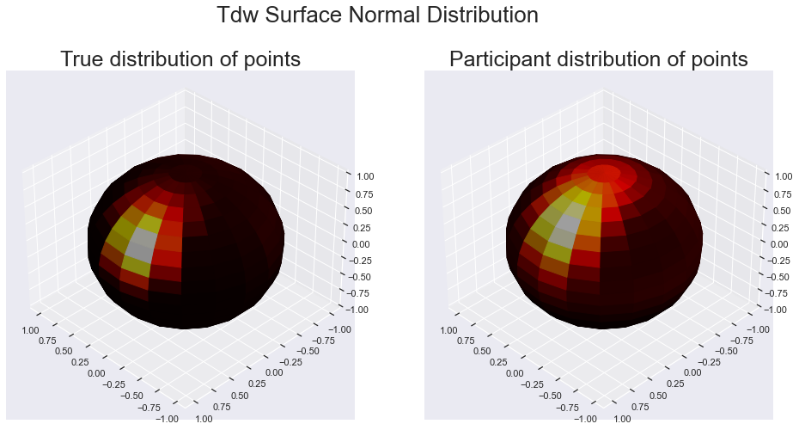
Surface Normals – TDW

Slide 16
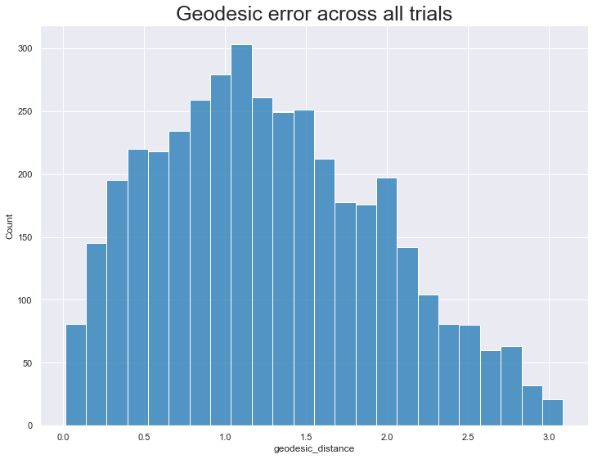
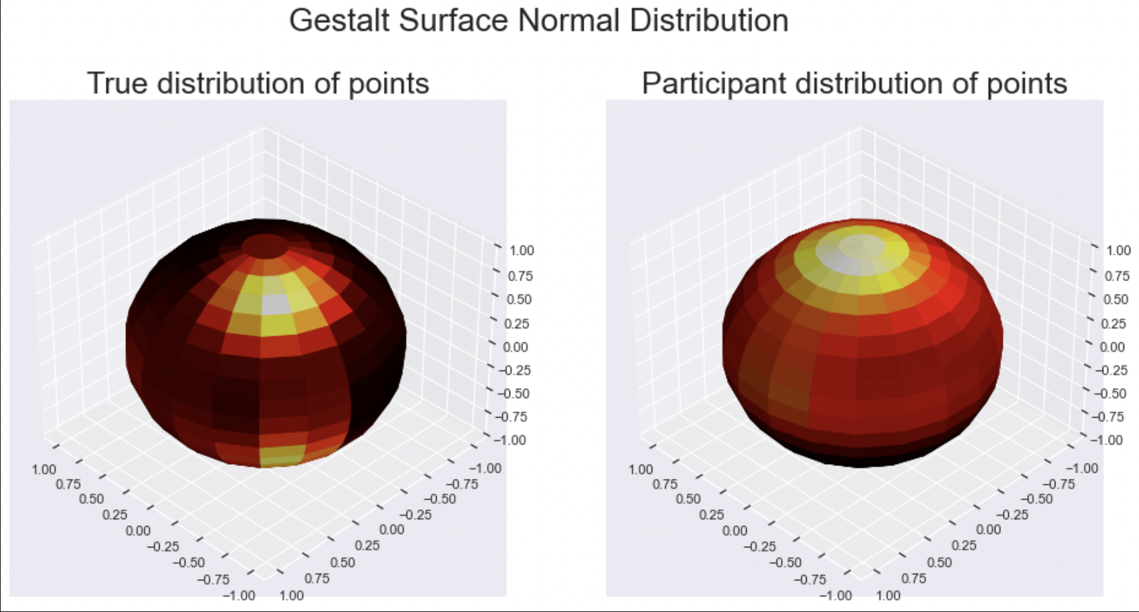
Surface Normals – Gestalt

Slide 17
Model Baselines
The goal is to test a variety of models across the suite of Tasks x Datasets
Working on developing methods for readouts (ie; how do you test a segmentation model on depth estimates)
Results TBD!

